Slide 1
Machine Learning Project
Laptop Price Prediction
By –
Ronit Wankhede

Slide 2

Problem Statement
The main objective of this project is to build a predictive model that can accurately estimate the price of a laptop given a set of relevant features such as brand, model, processor type, RAM, storage capacity, screen size, and graphics card, etc. The aim of the project is to develop and implement a model that can effectively learn from historical data and make accurate price predictions for new laptops in real-time.

Slide 3
Dataset
The Data used for this project can be found on Kaggle.
The dataset is about laptops configuration with prices containing 1303 laptop data with 12 columns: Company name, type, laptop size in (inches), Screen resolution, CPU, RAM, Memory, Graphics Card, Operating system and Price in INR.
For out Project the Price column from this dataset is to be considered as our target variable.

Slide 4
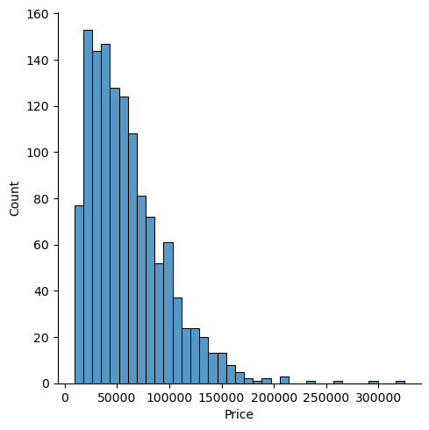
EDA
1. Price Distribution
Through this we can say that there are very budget oriented laptops in this list and very few high price ones.

Slide 5
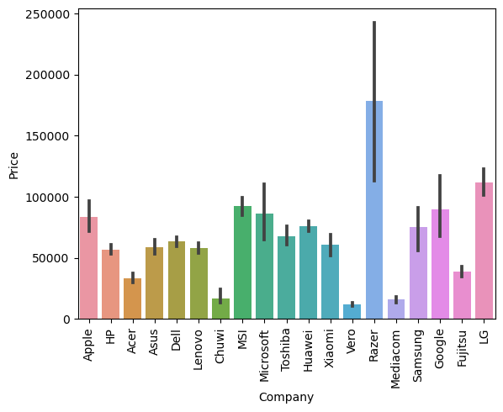
EDA
2. Price variation according to the company(brand of laptop)
Through this we can say that Razer compony has most costly laptops and Vero has most the low cost ones every other brand comes in between.

Slide 6
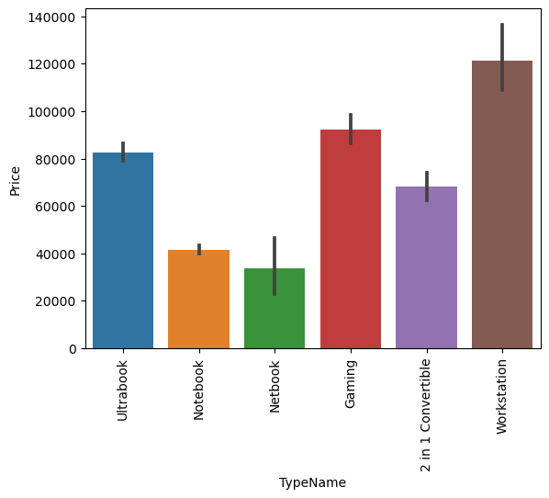
EDA
3. Price variation according to the laptop type.
Through this we can say that workstation types of laptops have high prices.

Slide 7
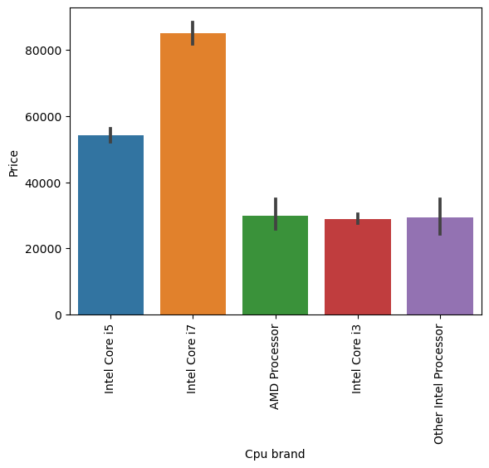
EDA
4. Price variation according to the CPU Brands.
Through this we can say that the Intel processors have high costing in general.

Slide 8
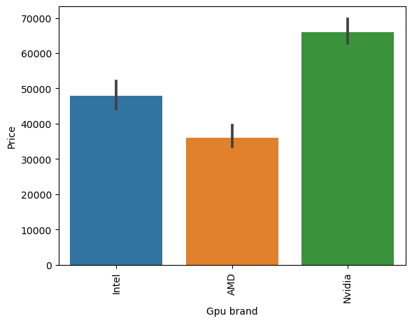
EDA
Price variation according to the GPU Brand
Through this we can say that laptops with Nvidia GPU have high price.

Slide 9
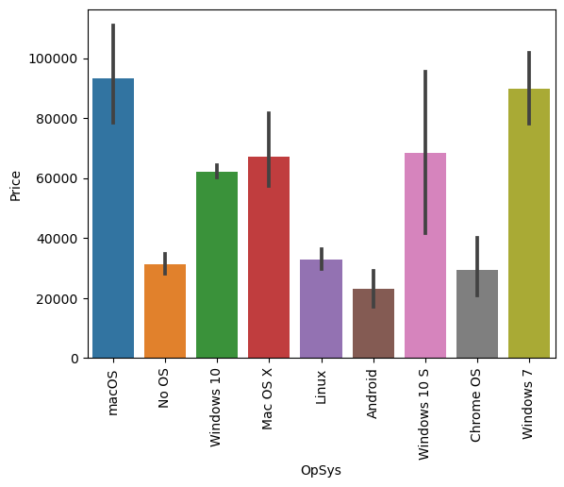
EDA
Price variation according to the OS.
Through this we can say that laptops with Windows and MacOS have high price.

Slide 10
Data Cleaning and Manipulation.
Changes to RAM and weight column.
Creating new columns with touchscreen and IPS types from the screenresolution column and then droped screenresolution.
And then actually extracting the resolution in 2 new col for x_res and y_res.
Creating a new column PPI (Pixel Per Inch) with help of x_res and y_res.
Creating CPU brand column from extracting CPU names from the CPU column and then dropped CPU.
Creating HDD, SSD, Flash drive and Hybrid columns with values from the Memory column and then dropped Memory.
Creating GPU brand from GPU column and then dropped GPU.
Creating OS column from OpSys and then dropped OpSys.

Slide 11
Modelling Score
As we can see the Voting regressor scored the highest in R2 score so it was selected for the deployment purpose.

Slide 12
Deployment
After the modeling process completion the model, the voting regressor model was saved along with newly created Data Frame.
Using the Streamlit Framework the model was integrated into a web page to predict price for specified configuration in it.

Slide 13
Conclusion
According to my created model the Voting Regressor was used in the deployment process which scored 0.88 R2 score and 0.16 MSE which can be improved in further stages by adding some more features to the model or by tweaking the features more properly to build the model.
After improving and implementing this model a individual can decide the budget for themselves after providing the desired configuration or can adjust their configuration according to their budget.

Slide 14
Thank You

